Slide 1
MODULE 4: 5G Security and Privacy
Security Challenges in 5G Networks
Authentication and Access Control in 5G
Encryption in 5G
Privacy-Preserving Techniques in 5G
Threats Detection and Mitigation in 5G Networks
Network Slice Isolation
Virtualized Infrastructure Security
Network Function Verification
Secure Over-the-Air (OTA) Updates

Slide 2
MODULE 4: 5G Security and Privacy
M4 S1
Security Challenges in 5G Networks

Slide 3
Security Challenges in 5G Networks
DOI: 10.1109/MCOMSTD.2018.1700063
According to the 3GPP, 5G will connect about 7 trillion wireless devices or things, shrink the average service creation time from 90 hours to 90 minutes, and enable advanced user-controlled privacy.
By connecting all aspects of life, 5G aims at a digital society that requires high service availability and security using a diverse set of technologies.
Therefore, the concepts of cloud computing, software-defined networking (SDN), and network functions virtualization (NFV) are sought out to meet the growing user and service demands within the constraints of capital expenditures (CapEx) and operational expenses (OpEx) through flexible network operation and management.

Slide 4
Security Challenges in 5G Networks
DOI: 10.1109/MCOMSTD.2018.1700063
However, recent research in these technologies reveals potential security challenges that must be addressed in order to ensure the security of new 5G services and infrastructures, and users.
For example, multi-tenant shared cloud infrastructures among multiple virtual network operators require strict isolation at multiple levels to avoid illegal resource consumption and maintain the integrity of users’ information of different operators.
According to the 3GPP, the security landscape, network slicing has several open security challenges such as security isolation of network slices and security of inter-slice communications.

Slide 5
Security Challenges in 5G Networks
DOI: 10.1109/MCOMSTD.2018.1700063
Moreover, programmable network architectures like SDN require strong authentication and authorization for applications to avoid misuse of the network resources exposed to applications through the control plane.
Similarly, misconfigurations of virtual network functions (VNFs) can lead to inter-federated conflicts creating jeopardy in the whole network.
Since 5G will connect every aspect of life to the network, having most users’ information stored and shared online, maintaining user privacy, will be highly challenging.

Slide 6
Security Challenges in 5G Networks
DOI: 10.1109/MCOMSTD.2018.1700063
1G
Wireless communication systems have been prone to security vulnerabilities from the very inception.
In 1G wireless networks, mobile phones, and wireless channels were targeted for illegal cloning and masquerading.
2G
Wireless networks, message spamming became common for not only pervasive attacks but injecting false information or broadcasting unwanted marketing information.

Slide 7
Security Challenges in 5G Networks
DOI: 10.1109/MCOMSTD.2018.1700063
3G
Wireless networks, and IP-based communication enabled the migration of Internet security vulnerabilities and challenges in the wireless domains.
4G
With the increased necessity of IP-based communication, 4G mobile networks enabled the proliferation of smart devices, multimedia traffic, and new services in the mobile domain.
5G
This development led to a more complicated and dynamic threat landscape.
With the advent of 5G wireless networks, the security threat vectors will be bigger than even before with greater concern for privacy.

Slide 8
Security Challenges in 5G Networks
DOI: 10.1109/MCOMSTD.2018.1700063
5G
Therefore, it is crucial to highlight the security challenges that not only are threatening due to the wireless nature of mobile networks, but also exist in the potential technologies that are highly important for 5G.

Slide 9
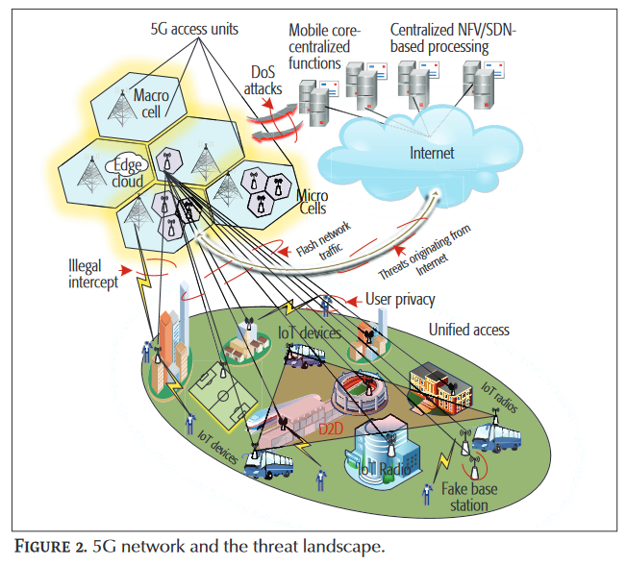
Key Security Challenges in 5G
DOI: 10.1109/MCOMSTD.2018.1700063
5G needs robust security architectures and solutions since it will connect every aspect of life to communication networks.
Therefore, we investigate and highlight the important security and privacy challenges in 5G networks (depicted in Fig) and overview the potential solutions that could lead to secure 5G systems

Slide 10
Key Security Challenges in 5G
DOI: 10.1109/MCOMSTD.2018.1700063
The basic challenges in 5G highlighted by Next Generation Mobile Networks (NGMN) are as follows:
• Flash network traffic: There will be a high number of end-user devices and new things (IoT).
• Security of radio interfaces: Radio interface encryption keys are sent over insecure channels
• User plane integrity: There is no cryptographic integrity protection for the user data plane
• Mandated security in the network: Service-driven constraints on the security architecture lead to the optional use of security measures.

Slide 11
Key Security Challenges in 5G
DOI: 10.1109/MCOMSTD.2018.1700063
The basic challenges in 5G highlighted by Next Generation Mobile Networks (NGMN) are as follows: (Cont..)
• Roaming security: User-security parameters are not updated with roaming from one operator network to another, leading to security compromises with roaming.
• Denial of service (DoS) attacks on the infrastructure: There are visible Network control elements and unencrypted control channels.
• Signaling storms: Distributed control systems require coordination, for example, non-access stratum (NAS) layer of Third Generation Partnership Project (3GPP) protocols.
• DoS attacks on end-user devices: There are no security measures for operating systems, applications, and configuration data on user devices..

Slide 12
Key Security Challenges in 5G
DOI: 10.1109/MCOMSTD.2018.1700063
The 5G design principles outlined by NGMN beyond radio efficiency include creating a common composable core and simplified operations and management by embracing new computing and networking technologies.
Therefore, we focused on the security of those technologies that will fulfill the design principles outlined by NGMN (i.e., mobile clouds, SDN, and NFV).

Slide 13
!!THANK YOU!! !! Have a Nice Day!!
Today we learned about
Security Challenges in 5G Networks

Slide 14
MODULE 4: 5G Security and Privacy
M4 S2
Authentication and Access Control in 5G
Encryption in 5G

Slide 15
Authentication and Access Control in 5G
https://doi.org/10.1016/j.future.2020.02.014.
The fifth generation of mobile networks, 5G, is expected to support a set of many requirements and use cases such as handling connectivity for a massive number of IoT (Internet of Things) devices.
Authenticating IoT devices and controlling their access to the network plays a vital role in the security of these devices and of the whole cellular system.
In current cellular networks, as well as in 3GPP specifications release 16 on 5G, the AAC (Authentication and Access Control) of IoT devices is done in the same manner as the AAC of MBB (Mobile Broadband) UE (User Equipment).
Considering the expected growth of IoT devices, this will likely induce a very high load on the connectivity provider’s CN (Core Network) and cause network failures.

Slide 16
Authentication and Access Control in 5G
https://doi.org/10.1016/j.future.2020.02.014.
Along with mobility, security is one of the most important aspects of cellular systems.
AAC (Authentication and access control) plays a vital role in ensuring the expected security level.
In 3G and 4G, authentication and access control of subscribers are done through AKA (authentication and key agreement) protocols.
These protocols (UMTS-AKA protocol in 3G and EPS-AKA in 4G) are based on the unique identities of subscribers and symmetric cryptographic algorithms

Slide 17
Authentication and Access Control in 5G
https://doi.org/10.1016/j.future.2020.02.014.
The system subscribers’ identities and the secret keys (that are used in symmetric cryptographic algorithms) are provisioned in secured elements (e.g., SIM cards or embedded SIM) and stored in cellular system’s database as well.
Executing these AKA protocols to establish a secure connection with the cellular system is mandatory for each UE (composed of a mobile device and a secured element) to obtain its cellular connectivity.
However, these well-established principles may prevent cellular systems from supporting the connectivity of a massive number of devices, in particular when considering the context of the IoT — where a high growth rate of connected devices is anticipated.
On one hand, most devices are constrained in terms of energy supply and computational capacities preventing them from running complex security protocols like EPS-AKA.

Slide 18
Authentication and Access Control in 5G
https://doi.org/10.1016/j.future.2020.02.014.
On the other hand, the tremendous number of attachment requests from these devices may induce signaling congestion by increasing the connectivity provider’s CN (Core Network) load.
The “Attach” procedure, that includes AAC, is indeed one of the most expensive procedures in terms of load on the CN (Core Network) .
5G defines three authentication methods:
5G-AKA, (5G-Authentication and Key Management Agreement)
EAP-AKA’, (Extensible Authentication Protocol-Authentication and Key Agreement )
EAP-TLS. (Extensible Authentication Protocol – Transport Layer Security)

Slide 19
Authentication and Access Control in 5G
https://doi.org/10.1016/j.future.2020.02.014.
Extensible Authentication Protocol, abbreviated as EAP, is an authentication framework that supports multiple authentication methods.
The EAP-AKA is an EAP method for authentication and session key distribution that uses AKA mechanism.
Authentication and Key Agreement (AKA) is based on challenge-response mechanisms and symmetric cryptography.
AKA typically runs in a UMTS Subscriber Identity Module (USIM) or a CDMA2000 (Removable) User Identity Module ((R)UIM).
Based on EAP-AKA, EAP-AKA' is a new EAP method that binds the derived keys to the name of the access network.

Slide 20
Authentication and Access Control in 5G
https://doi.org/10.1016/j.future.2020.02.014.
A Basic, Successful Full EAP-AKA' Authentication Procedure
The UE (or the identity module in it) and the test set (as an authentication server) have agreed on a shared authentication key beforehand.
The test set sends an EAP-Request /Identity message to the UE. The UE replies with an EAP-Response /Identity message which includes the UE's NAI (Network Access Identifier). The NAI will be used in the following step as an input parameter to generate the authentication vector.
The actual authentication process starts. The test set produces an authentication vector based on the authentication key, the sequence number and the network name etc. The authentication vector contains a random part RAND, an authenticator part AUTN used for authenticating the network to the UE, and other keys including IK' for integrity check, CK' for encryption etc.

Slide 21
Authentication and Access Control in 5G
https://doi.org/10.1016/j.future.2020.02.014.
A Basic, Successful Full EAP-AKA' Authentication Procedure (Cont.)
The RAND, AUTN and the network name are delivered to the UE via EAP-Request/AKA'-Challenge message.
The UE verifies the AUTN, again based on the authentication key and the sequence number. If the AUTN is valid and the sequence number used to generate AUTN is within the correct range, the UE produces an authentication result RES and sends it to the test set via EAP-Response/AKA'-Channelled message.
The test set verifies the RES and MAC values received from the UE. If the results are correct, the test set sends an EAP success message to the UE. IK', CK' together with other key materials can be used to protect further communications between the UE and the test set.

Slide 22
Encryption in 5G
The security of the radio interface keys is still a challenge, as it needs secure exchange of keys encrypted like the Host Identity Protocol (HIP)-based schemes.
The same end-to-end encryption protocol can be used for user plane integrity.
Roaming security and network-wide mandated security policies can be achieved using centralized systems that have a global visibility of the users’ activities and network traffic behavior (e.g., SDN).
Signaling storms will be more challenging due to the excessive connectivity of UEs, small base stations, and high user mobility.
The cloud radio access network (C-RAN) and edge computing are the potential problem solvers for these challenges, but the design of these technologies must consider the increase in signaling traffic as an important aspect of the future networks as described by NGMN.

Slide 23
Encryption in 5G
What is end-to-end encryption?
End-to-end encryption (E2EE) is a method of secure communication that prevents third parties from accessing data while it's transferred from one end system or device to another.
In E2EE, the data is encrypted on the sender's system or device, and only the intended recipient can decrypt it. As it travels to its destination, the message cannot be read or tampered with by an internet service provider (ISP), application service provider, hacker or any other entity or service.

Slide 24
Encryption in 5G
How does end-to-end encryption work?
The cryptographic keys used to encrypt and decrypt the messages are stored on the endpoints. This approach uses public key encryption.
Public key, or asymmetric, encryption uses a public key that can be shared with others and a private key.
Once shared, others can use the public key to encrypt a message and send it to the owner of the public key.
The message can only be decrypted using the corresponding private key, also called the decryption key.

Slide 25
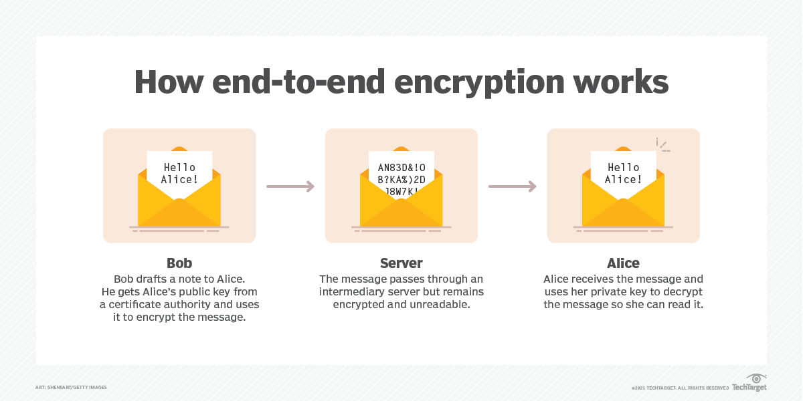
Encryption in 5G
How does end-to-end encryption work?

Slide 26
Encryption in 5G
How does end-to-end encryption work?
In online communications, there is almost always an intermediary handing off messages between two parties involved in an exchange.
That intermediary is usually a server belonging to an ISP, a telecommunications company or a variety of other organizations.
The public key infrastructure E2EE uses ensures the intermediaries cannot eavesdrop on the messages that are being sent.

Slide 27
!!THANK YOU!! !! Have a Nice Day!!
Today we learned about
Authentication and Access Control in 5G
Encryption in 5G

